Slide 1

EMAIL-SPAM FILTRATION
Group 11:
Rajan Walia
Mendrela Biswas
Anish Sharma
Rahul Angalakuduti
Sai Krishna Boppana
17th April 2020

Slide 2
Overview
Introduction
Problem Statement
Executive Summary
Approach
Algorithm Selection
Project Breakdown Structure
PEP 8 codes
AWS and Docker Deployment
Conclusion

Slide 3
Introduction
Emails are a part of day to day communication
Spam mails
Loss of productivity
Malware Intrusion
Fraud detection

Slide 4

Problem Statement E-mail users are getting hundreds of spam and non-spam emails. This makes their life uncomfortable as it wastes their precious time, may result in loss of important emails, lead to malicious activity (ie: by session hijacking and phishing, etc.).

Slide 5

Executive Summary
Scope: Create ML model to filter spam emails and move them in junk/spam folder.
In-scope: - Identify spam and non-spam email - Direct into junk box of mailbox
Out-of-Scope: - Direct non-spam mail into primary Mail box.
Goals: User gets filtered emails on their primary mailbox and spam emails on junk/spam.
4

Slide 6




Approach
Final Product
Data Gathering
Implement the Model
6. After testing and modification final model extraction, which apply on application.
2. Gathering the right type and amount of data.
4. We choose the best model based on accuracy, processing, error rate.
Analyze the prob
EDA & Preprocessing
Testing
Deployment
1.) Analyze the problem deeply and understand the negatives associated with it.
3. Contractions, Word Tokenize, Removing Stop Words
5. Testing model using various ways and giving various types of data.
8. Deploying code in AWS
6
www.free-powerpoint-templates-design.com

Slide 7
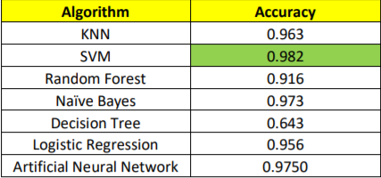
Algorithm Selection

Slide 8
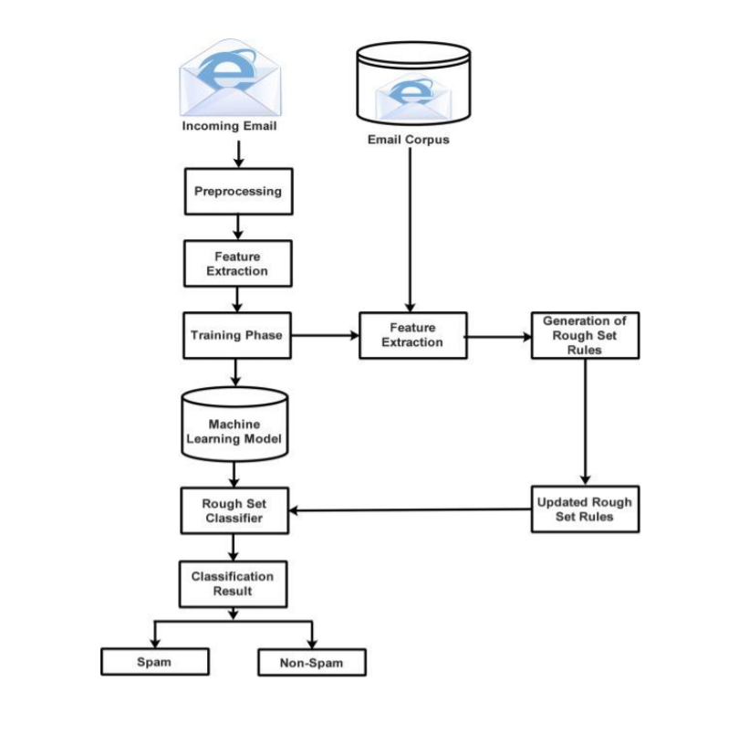
Project Breakdown Structure
8

Slide 9
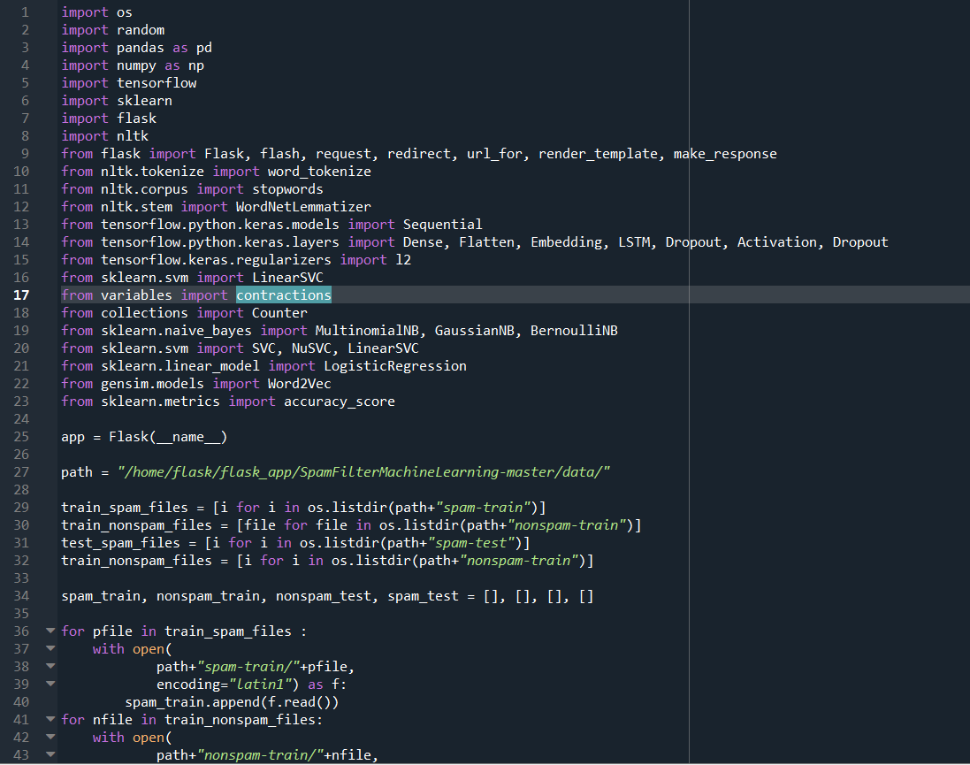
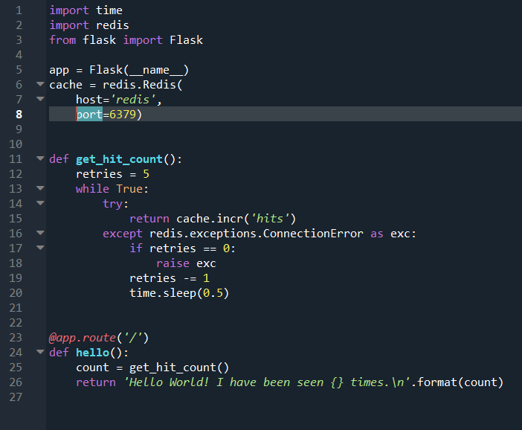
PEP 8 Codes
Final_capstone.py
app.py

Slide 10
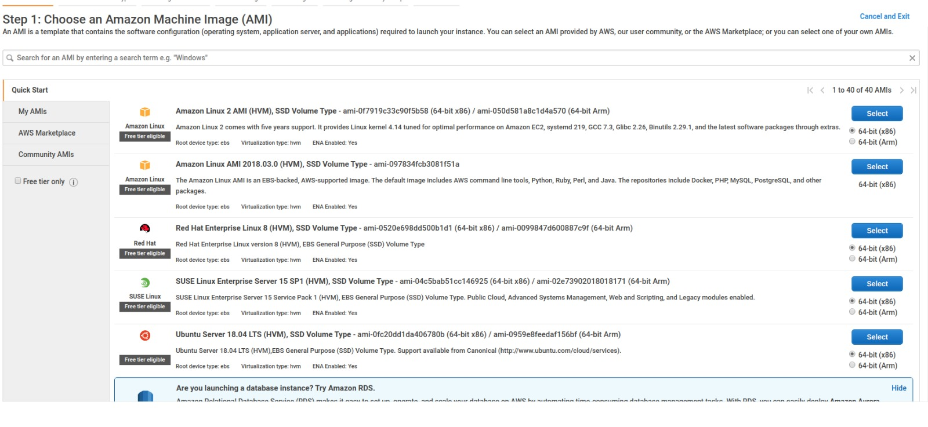
AWS Deployment http://3.133.151.114:5000/index

Slide 11
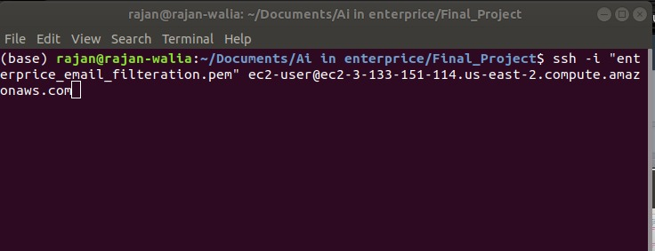
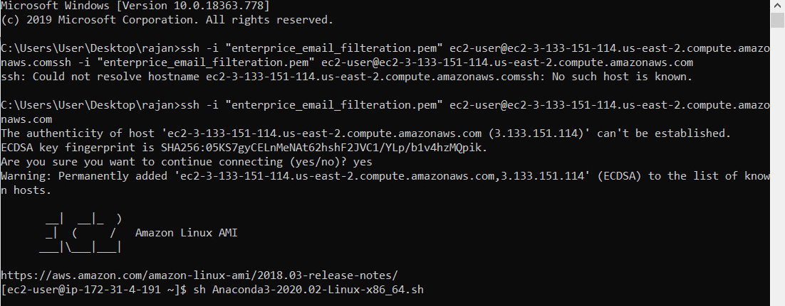
AWS and Docker Deployment

Slide 12
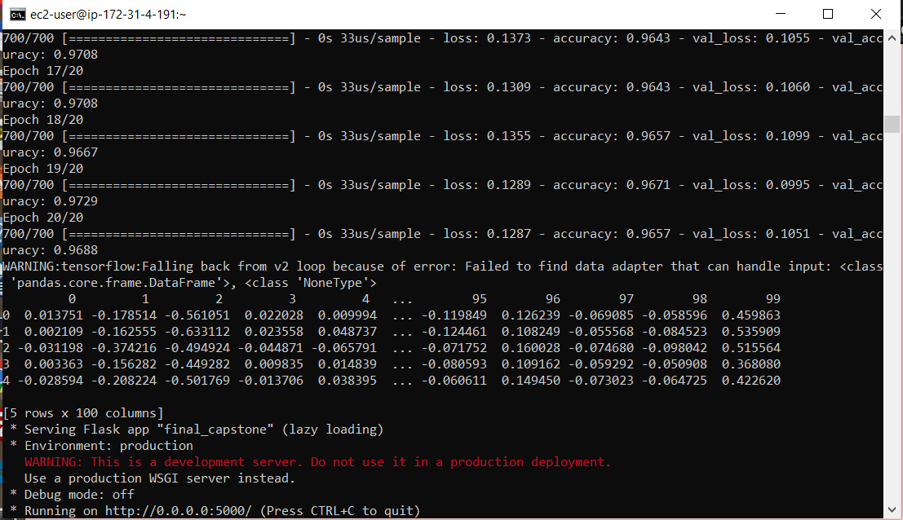
AWS and Docker Deployment

Slide 13
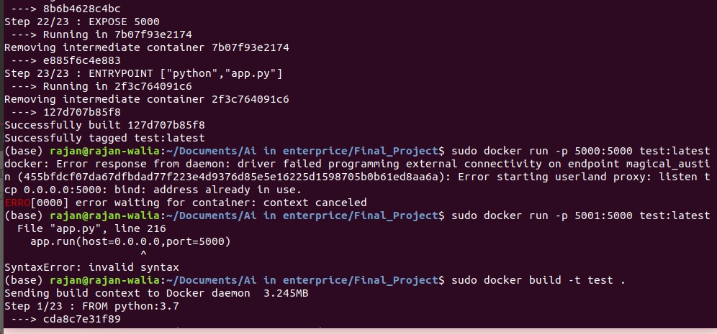
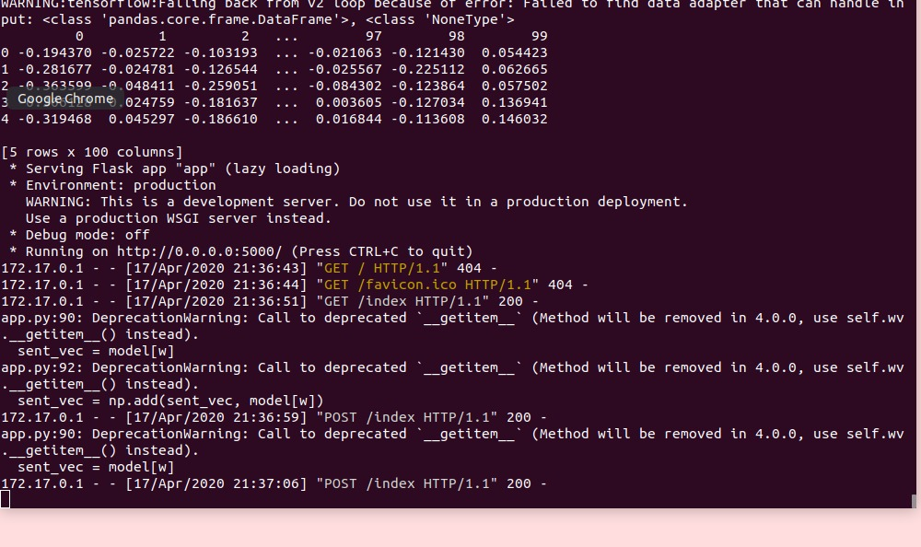
AWS and Docker Deployment http://ec2-18-191-227-172.us-east-2.compute.amazonaws.com:5000/index

Slide 14
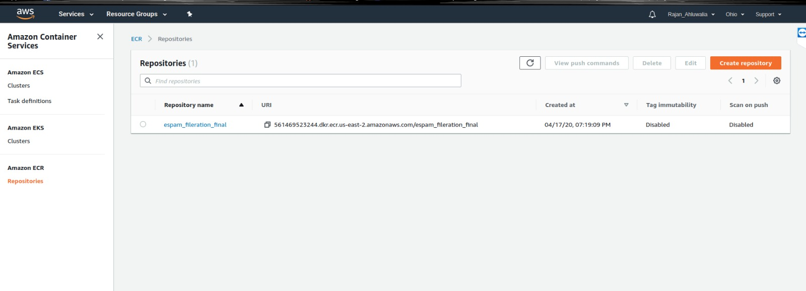
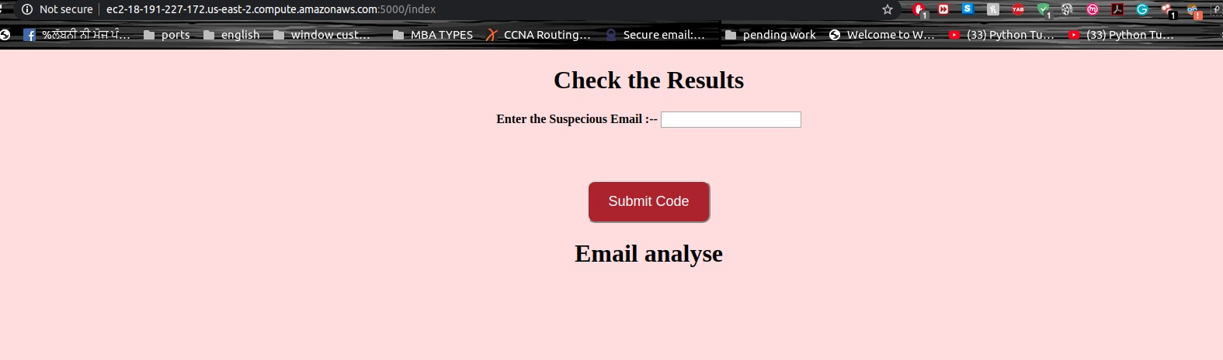
AWS and Docker Deployment http://3.133.151.114:5000/index

Slide 15
Conclusion
Email filtration becomes an essential need for the email clients. Pre- trained word embeddings significantly aid to improve the model performance. We implemented various algorithms and received the best results from SVM.

Slide 16

Thank You

